Slide 1






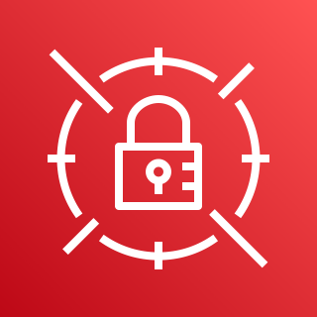




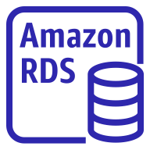

AWS Cloud
Availability Zone 1
Availability Zone 2
VPC
Private subnet
Private subnet
AWS Systems Manager
Amazon EC2 (AMH/SAA or Lite2)
Amazon EC2 (AMH/SAA or Lite2)
Private subnet
Private subnet
Amazon CloudWatch
Colocation site or customer premises
SWIFT network backbone access points (BAPs)
Amazon EC2 (SAG/SNL)
Amazon EC2 (SAG/SNL)
AWS Secrets Manager
Private subnet
Private subnet
VPN gateway
AWS Direct Connect
Additional corporate
data center
Oracle instance
Oracle instance
Private subnet
Private subnet
(Optional) Amazon MQ
(Optional) Amazon MQ
Notes:
Figure 1

